Slide 1
Time Delay in 8085
Presented by:
Dr. Sk Babar Ali
Associate Professor
ECE department, Aliah University

Slide 2
Time Delay in 8085
Why we use delay?
What is clock & T state?
Type of delay-NOP, REGISTER, REGISTER PAIR, LOOP, LOOP WITH IN LOOP.
How to make delay program.

Slide 3
Why we use delay?
Processor is very fast.
Devices are not fast.
We are not.

Slide 4
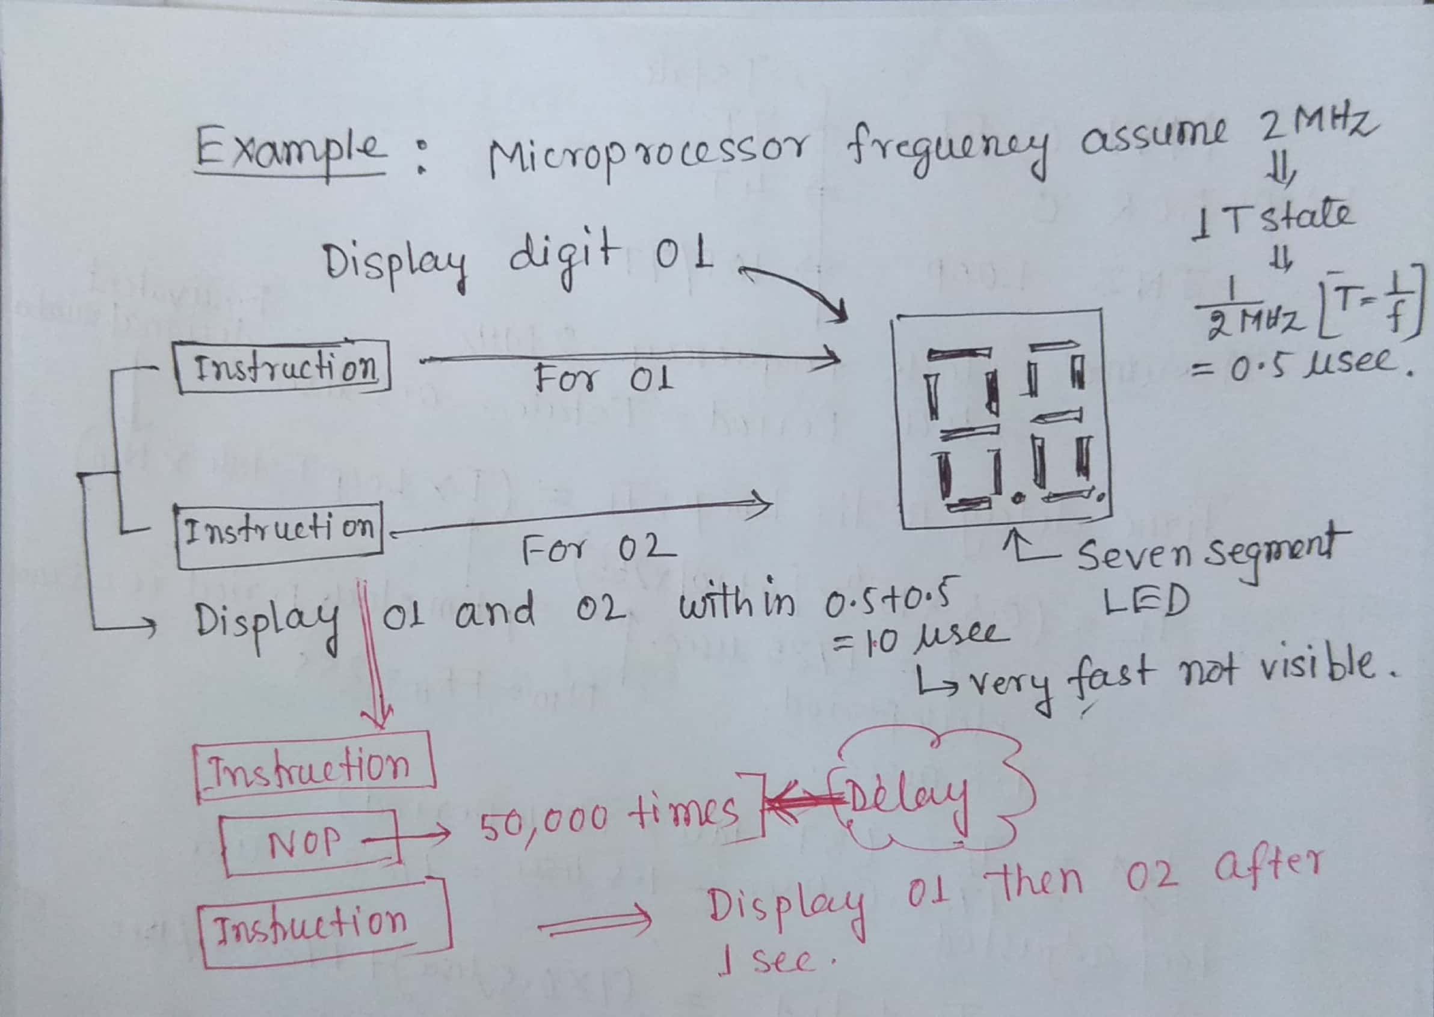

Slide 5
What is clock & T state?
It provide timing pulses to everything in processor for synchronization for operation like instruction read, data receives, execute, result.
T state is Fashionable name given to 1 complete clock cycle.
If clock is 2 MHz: T state= 1/f=1/2MHz=0.5µsec.

Slide 6
Type of delay
NOP
REGISTER
REGISTER PAIR
LOOP
LOOP WITH IN LOOP

Slide 7
Type of delay
NOP
no operation.
Waste the processor time.
REGISTER
REGISTER PAIR
LOOPLOOP WITH IN LOOP(LOOP INSIDE LOOP)
Important for exam.

Slide 8
Type of delay
NOP- DELAY
OUT 01H
NOP Time delay = (4T+4T+4T+4T)
NOP = 16X0.5µsec
NOP = 8 µsec
NOP
OUT 02H

Slide 9
Type of delay
REGISTER- DELAY

Slide 10
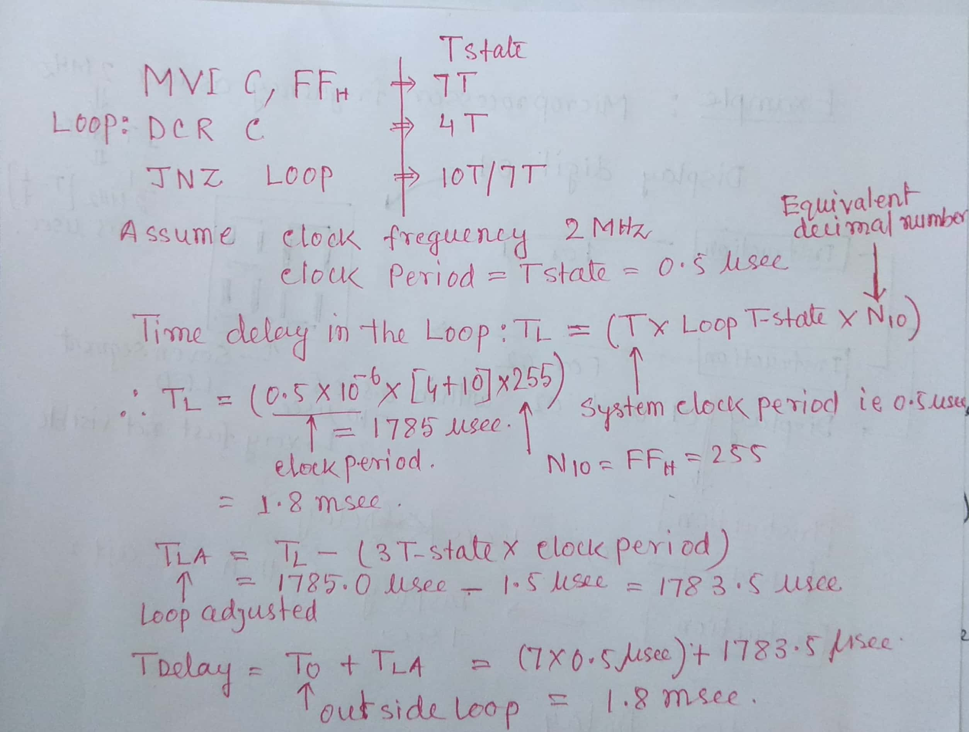

Slide 11
Type of delay
REGISTER PAIR- DELAY

Slide 12
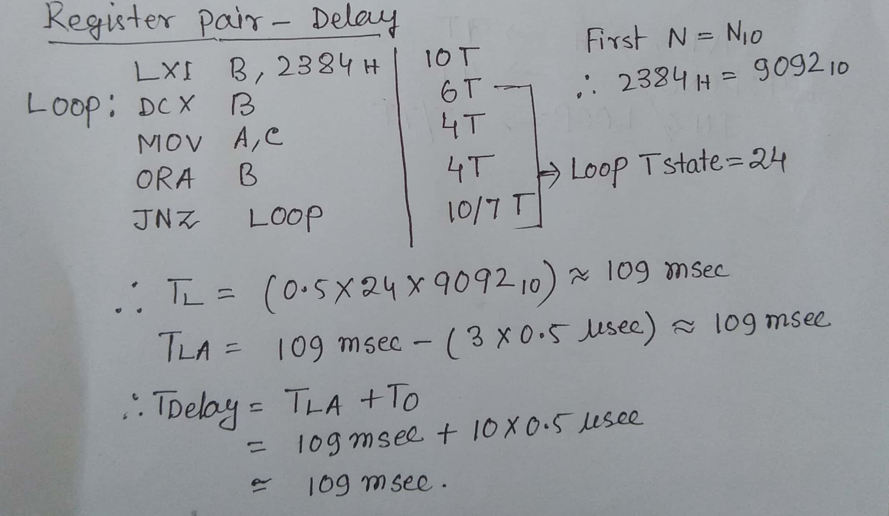

Slide 13
Types of delay
Loop inside- delay

Slide 14
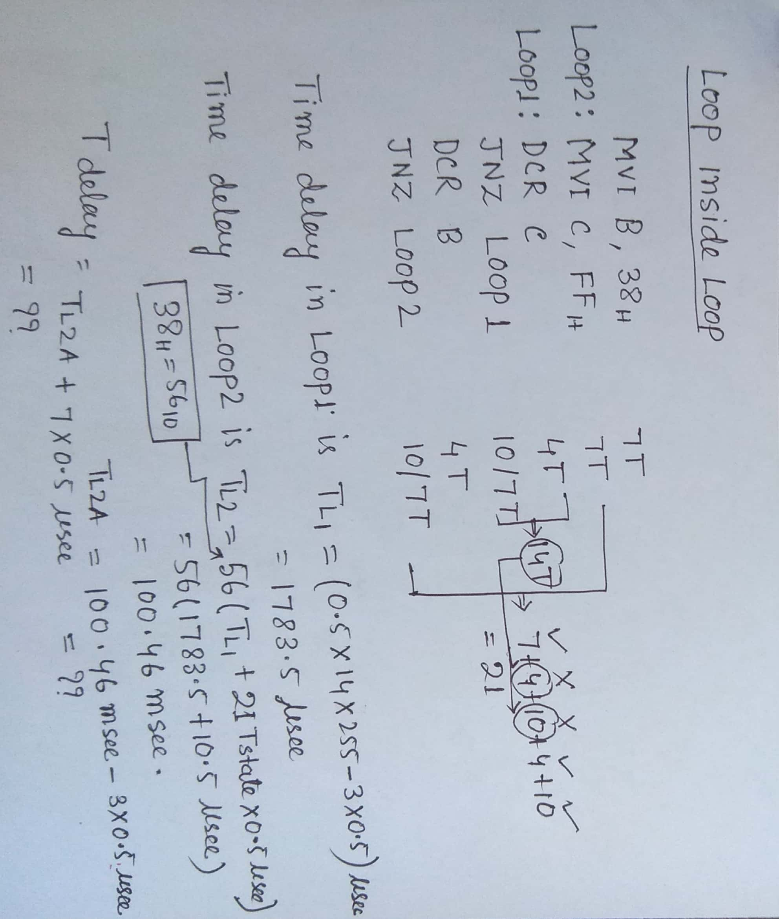

Slide 15
Types of delay
Make- Time-delay

Slide 16
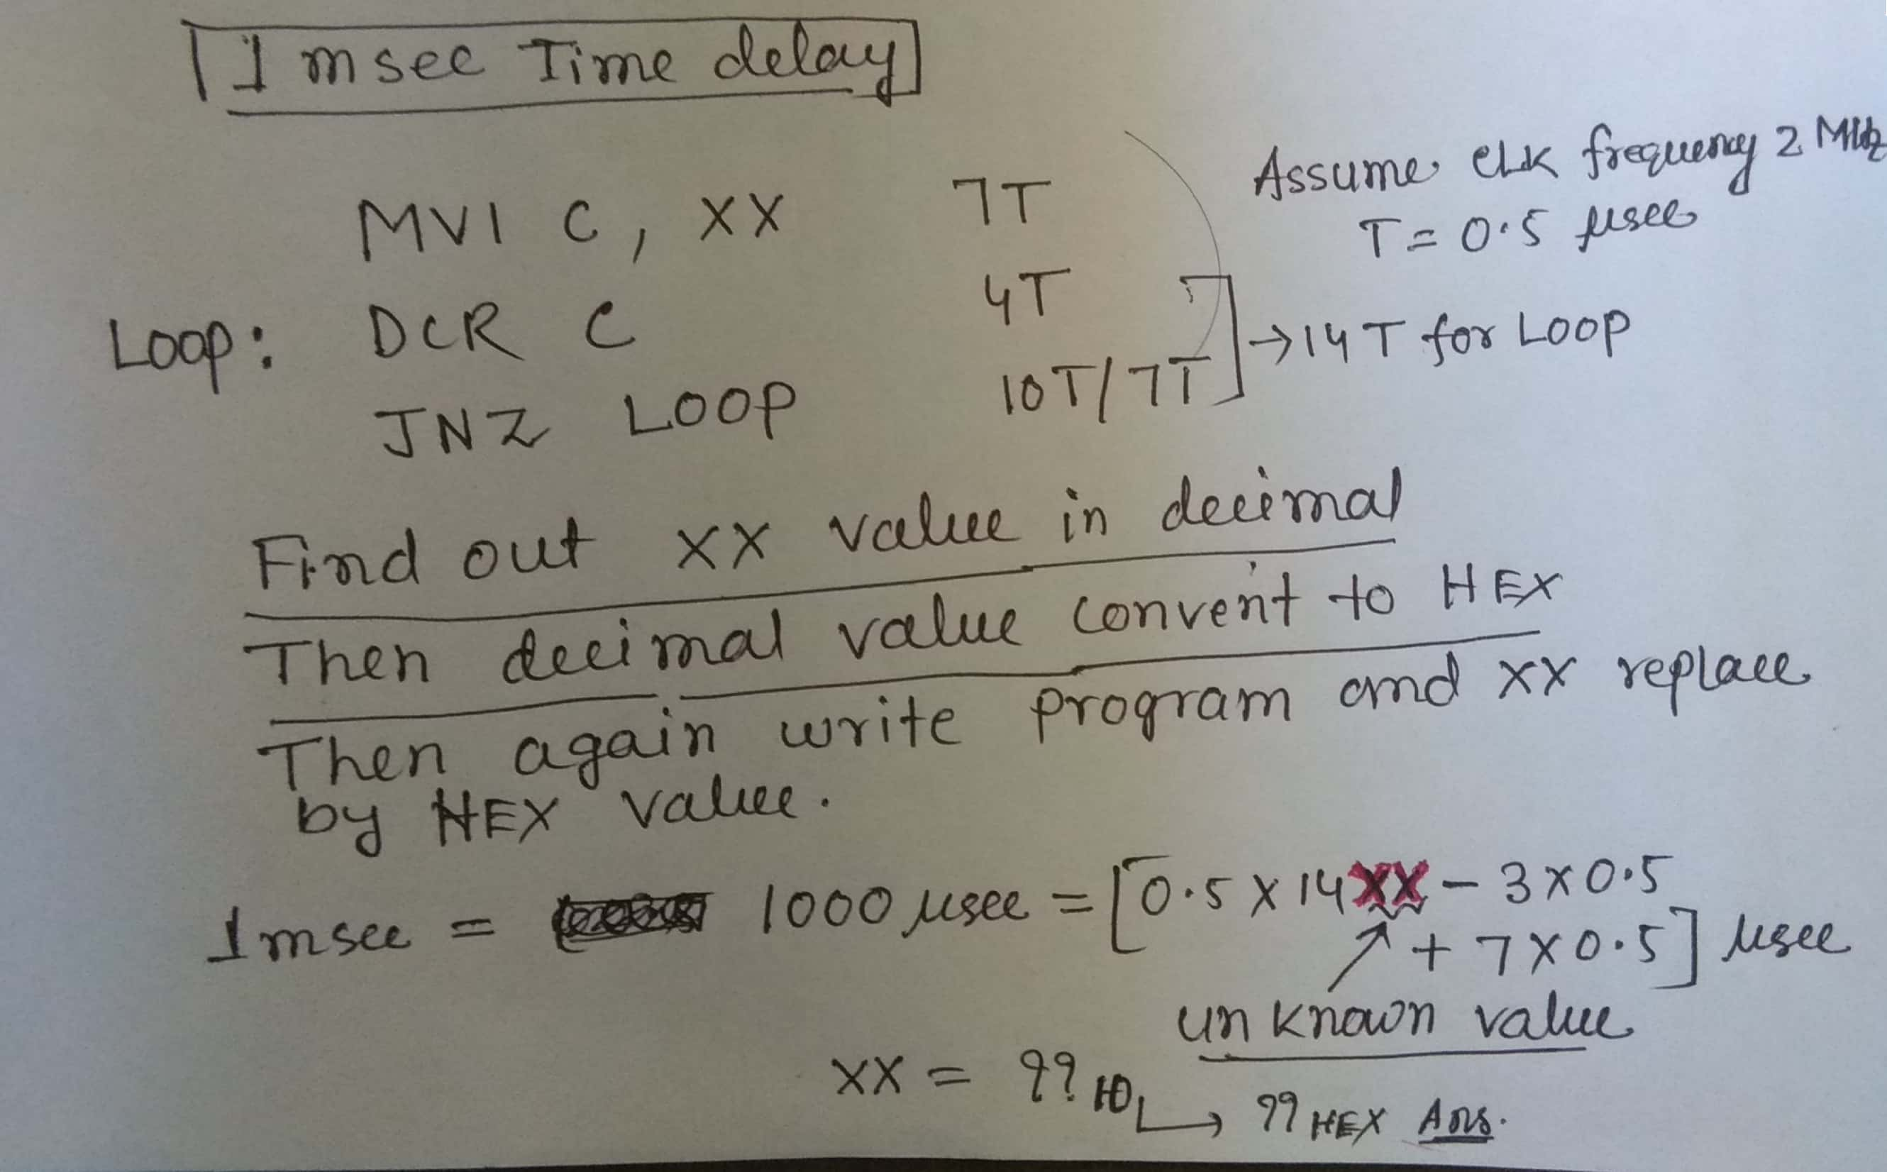

Slide 17
Any questions…….

